Slide 1
Pyspark

Slide 2
outline
PySpark Introduction
PySpark Features & Advantages
PySpark Architecture
Installation on Windows
Spyder IDE & Jupyter Notebook
RDD
DataFrame
SQL
Streaming
MLlib

Slide 3
Introduction
PySpark is the Python API for Apache Spark.
PySpark enables developers to write Spark applications using Python, providing access to Spark’s rich set of features and capabilities through Python language.
With its rich set of features, robust performance, and extensive ecosystem,
PySpark has become a popular choice for data engineers, data scientists, and developers working with big data and distributed computing.

Slide 4
Intro. ...
Apache Spark is an open-source unified analytics engine used for large-scale data processing, hereafter referred it as Spark.
Spark is designed to be fast, flexible, and easy to use, making it a popular choice for processing large-scale data sets.
Spark runs operations on billions and trillions of data on distributed clusters 100 times faster than traditional applications

Slide 5
Spark reuses data by using an in-memory cache to speed up machine learning algorithms that repeatedly call a function on the same dataset.
This lowers the latency making Spark multiple times faster than MapReduce, especially when doing machine learning, and interactive analytics.
Apache Spark can also process real-time streaming.

Slide 6
It is also a multi-language engine, that provides APIs (Application Programming Interfaces) and libraries for several programming languages like Java, Scala, Python, and R, allowing developers to work with Spark using the language they are most comfortable with.

Slide 7
Scala: Spark’s primary and native language is Scala. Many of Spark’s core components are written in Scala, and it provides the most extensive API for Spark.
Java: Spark provides a Java API that allows developers to use Spark within Java applications. Java developers can access most of Spark’s functionality through this API.
Python: Spark offers a Python API, called PySpark, which is popular among data scientists and developers who prefer Python for data analysis and machine learning tasks. PySpark provides a Pythonic way to interact with Spark.
R: Spark also offers an R API, enabling R users to work with Spark data and perform distributed data analysis using their familiar R language.

Slide 8
Who uses PySpark?
PySpark is very well used in the Data Science and Machine Learning community as there are many widely used data science libraries written in Python including NumPy, and TensorFlow. Also used due to its efficient processing of large datasets.

Slide 9
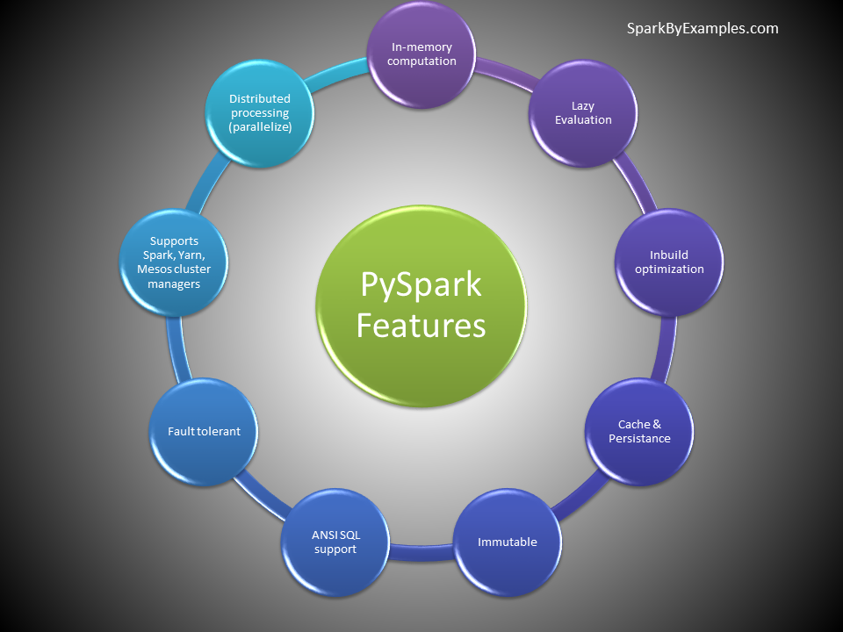
PySpark Features & Advantages
The following are the main features of PySpark.

Slide 10
Python API: Provides a Python API for interacting with Spark, enabling Python developers to leverage Spark’s distributed computing capabilities.
Distributed Computing: PySpark utilizes Spark’s distributed computing framework to process large-scale data across a cluster of machines, enabling parallel execution of tasks.
Fault Tolerance: Automatically handles fault tolerance by maintaining resilient distributed datasets (RDDs), which allows it to recover from failures gracefully.
Lazy Evaluation: PySpark employs lazy evaluation, meaning transformations on data are not executed immediately but rather stored as a directed acyclic graph (DAG) of computations until an action is triggered.

Slide 11
Integration with Python Ecosystem: Seamlessly integrates with the Python ecosystem, allowing users to leverage popular Python libraries such as pandas, NumPy, and scikit-learn for data manipulation and machine learning tasks.
Interactive Data Analysis: PySpark is well-suited for interactive data analysis and exploration, thanks to its integration with Jupyter Notebooks and interactive Python shells.
Machine Learning: PySpark includes MLlib, Spark’s scalable machine learning library, which provides a wide range of machine learning algorithms for classification, regression, clustering, and more.

Slide 12
Streaming Processing: Supports streaming processing through Spark Streaming, enabling real-time data processing and analysis on continuous data streams.
SQL Support: Allows users to perform SQL queries on distributed datasets using Spark SQL, providing a familiar interface for working with structured data.

Slide 13
PySpark Advantages
The most important advantages of using PySpark include:
Scalability: PySpark harnesses the power of distributed computing, enabling processing of large-scale datasets across clusters of machines, thus accommodating growing data needs.
Performance: By leveraging in-memory computing and parallel processing, PySpark achieves high performance, enabling faster data processing and analysis compared to traditional single-node processing.
Ease of Use: Provides a user-friendly Python API, making it accessible to Python developers familiar with the language syntax and ecosystem. It also integrates well with popular Python libraries for data analysis and machine learning.

Slide 14
Fault Tolerance: Automatically handles fault tolerance through resilient distributed datasets (RDDs), ensuring data reliability and recovery from failures without manual intervention.
Unified Platform: Offers a unified platform for various data processing tasks, including batch processing, interactive data analysis, streaming processing, and machine learning, simplifying development and deployment workflows.
Real-time Processing: With Streaming and Structured Streaming, PySpark enables real-time processing of data streams, facilitating timely insights and responses to changing data.

Slide 15
Machine Learning Capabilities: Includes MLlib, machine learning library, providing scalable implementations of popular machine learning algorithms, allowing for large-scale model training and deployment.
Community and Ecosystem: PySpark benefits from a vibrant community and ecosystem, offering extensive documentation, tutorials, and third-party packages, as well as continuous development and support from the community.

Slide 16
PySpark Architecture
PySpark architecture consists of a driver program that coordinates tasks and interacts with a cluster manager to allocate resources.
The driver communicates with worker nodes, where tasks are executed within an executor’s JVM.
SparkContext manages the execution environment, while the DataFrame API enables high-level abstraction for data manipulation.
SparkSession provides a unified entry point for Spark functionality.
the cluster manager oversees resource allocation and task scheduling across nodes, facilitating parallel computation for processing large-scale data efficiently.

Slide 17


Slide 18
Cluster Managers
Cluster managers in PySpark are responsible for resource allocation and task scheduling across nodes in a distributed computing environment.
Standalone: The standalone cluster manager is a simple, standalone solution bundled with Spark that manages resources for applications. It’s suitable for small to medium-sized clusters and doesn’t require additional software installation.
Mesos: Mesos is a distributed systems kernel that abstracts CPU, memory, storage, and other compute resources across a cluster. PySpark can leverage Mesos as a cluster manager, allowing efficient resource sharing among multiple frameworks like Spark, Hadoop, and others.

Slide 19
Hadoop YARN (Yet Another Resource Negotiator): YARN is Hadoop’s resource management layer, responsible for managing and scheduling resources across a Hadoop cluster. PySpark can run on YARN, enabling seamless integration with existing Hadoop ecosystems and leveraging YARN’s resource management capabilities.
Kubernetes: Kubernetes is a container orchestration platform that automates deployment, scaling, and management of containerized applications. PySpark can run on Kubernetes, enabling dynamic resource allocation and efficient utilization of resources in containerized environments.

Slide 20
local – “local” is a special value used for the master parameter when initializing a SparkContext or SparkSession. When you specify local as the master, it means that Spark will run in local mode, utilizing only a single JVM (Java Virtual Machine) on the local machine where your Python script is executed.
Each cluster manager type offers unique features and benefits, catering to different deployment scenarios and infrastructure requirements. The choice of cluster manager depends on factors such as scalability, resource isolation, integration with existing infrastructure, and ease of management.

Slide 21
PySpark Modules & Packages
PySpark module enables Python developers to interact with Spark, leveraging its powerful distributed computing capabilities. It provides a Python API that exposes Spark’s functionality, allowing users to write Spark applications using Python programming language.
RDD (pyspark.RDD)
DataFrame and SQL (pyspark.sql)
Streaming (pyspark.streaming)
MLib (pyspark.ml, pyspark.mllib)
GraphFrames (GraphFrames)
Resource (pyspark.resource)

Slide 22
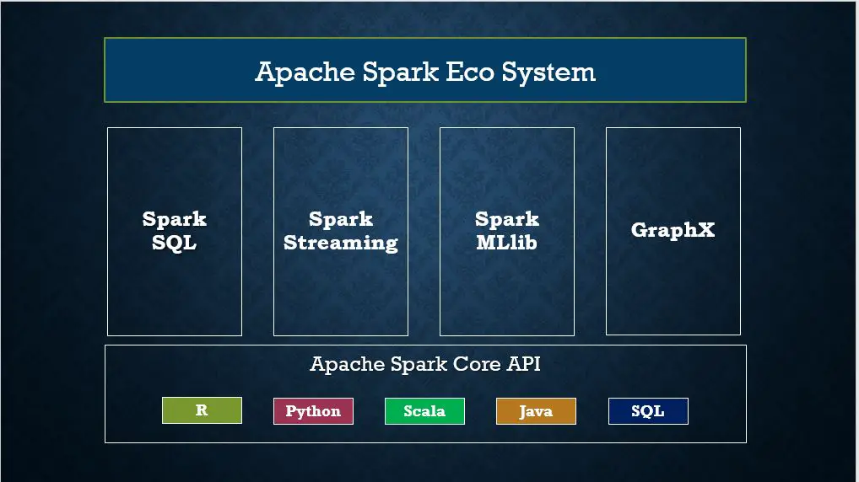

Slide 23
PySpark RDD – Resilient Distributed Dataset
PySpark RDD (Resilient Distributed Dataset) is a fundamental data structure that is fault-tolerant, immutable, and distributed collections of objects.
RDDs are immutable, meaning they cannot be changed once created. Any transformation on an RDD results in a new RDD.
Each dataset in RDD is divided into logical partitions, which can be computed on different nodes of the cluster.

Slide 24
RDD Creation
In order to create an RDD, first, you need to create a SparkSession which is an entry point to the PySpark application. SparkSession can be created using a builder() or newSession() methods of the SparkSession.
Spark session internally creates a sparkContext variable of SparkContext

Slide 25
create an RDD from a text file using textFile() function of the SparkContext.
# Import SparkSession
from pyspark.sql import SparkSession
# Create SparkSession
spark = SparkSession.builder \
.master("local[1]") \
.appName("SparkByExamples.com") \
.getOrCreate()
# Create RDD from external Data source
rdd2 = spark.sparkContext.textFile("/path/test.txt")

Slide 26
RDD Operations
two types of operations on RDD;
Transformations and
Actions.
RDD transformations in PySpark are lazy operations and they execute only when an action is called on RDD.

Slide 27
Transformation operations are map, filter, flatMap, groupByKey, reduceByKey, join, union, sortByKey, distinct, sample, mapPartitions, and aggregateByKey. These functions transform RDDs by applying computations in a distributed manner across a cluster of machines and return a new RDD
RDD actions in PySpark trigger computations and return results to the Spark driver. Key actions include collect, count, take, reduce, foreach, first, takeOrdered, takeSample, countByKey, saveAsTextFile, saveAsSequenceFile, saveAsObjectFile, foreachPartition, collectAsMap, aggregate, and fold.

Slide 28
PySpark DataFrame is mostly similar to Pandas DataFrame, with the exception that DataFrames are distributed in the cluster (meaning the data in data frames are stored in different machines in a cluster), and any operations in PySpark execute in parallel on all machines, whereas Panda Dataframe stores and operates on a single machine.

Slide 29
Is PySpark faster than pandas?
PySpark is a distributed computing framework well-suited for processing large-scale datasets that exceed the memory capacity of a single machine. It can leverage parallel processing across a cluster of machines, enabling faster computations on massive datasets.
On the other hand, pandas, being a single-machine library, is optimized for smaller to medium-sized datasets that can fit into memory. It typically performs well for data manipulation and analysis tasks on small to medium datasets.

Slide 30
Creating DataFrame
# Create DataFrame
data = [('James','','Smith','1991-04-01','M',3000),
('Michael','Rose','','2000-05-19','M',4000),
('Robert','','Williams','1978-09-05','M',4000),
('Maria','Anne','Jones','1967-12-01','F',4000),
('Jen','Mary','Brown','1980-02-17','F',-1)
]
columns = ["firstname","middlename","lastname","dob","gender","salary"]
df = spark.createDataFrame(data=data, schema = columns)

Slide 31
To display the DataFrame use df.show() which shows the 20 rows by default.DataFrame Operations
Rename column on DataFrame
Add column to DataFrame
Filter rows from DataFrame
Sort DataFrame Rows
Using xplode array and map columns to rows
Explode nested array into rows

Slide 32
Apache Spark, by default, supports a rich set of APIs to read and write several file formats.
Text Files (.txt)
CSV Files (.csv)
TSV Files (.tsv)
Avro Files (.avro)
JSON Files (.json)
Parquet (.parquet)
ORC Files (.orc)
XML Files and many other formats

Slide 33
# Create DataFrame from CSV file
df = spark.read.csv("/tmp/resources/zipcodes.csv")
df.printSchema()

Slide 34
PySpark SQL
PySpark SQL is a module in Spark that provides a higher-level abstraction for working with structured data and can be used SQL queries.
SQL enables you to write SQL queries against structured data, leveraging standard SQL syntax and semantics. This familiarity with SQL allows users with SQL proficiency to transition to Spark for data processing tasks easily.

Slide 35
First, you should create a temporary table or view on DataFrame to use SQL queries. Once the table is created, you can be accessed throughout the SparkSession using sql().
These tables and views are scoped to the SparkSession that created them. Once the SparkSession is terminated, either by closing the Spark application or ending the Spark session explicitly, the temporary views are removed from memory.
To run SQL queries, use sql() method of the SparkSession object. Note that this function returns a DataFrame.

Slide 36
# Create temporary table
df.createOrReplaceTempView("PERSON_DATA")
# Run SQL query
df2 = spark.sql("SELECT * from PERSON_DATA")
df2.printSchema()
df2.show()

Slide 37
# Using groupby
groupDF = spark.sql("SELECT gender, count(*) from PERSON_DATA group by gender")
groupDF.show()

Slide 38
PySpark Streaming
Spark Streaming is a real-time data processing framework in Apache Spark that enables developers to process and analyze streaming data from various sources like file system folders, TCP sockets, S3, Flume, Kafka, Twitter, and Amazon Kinesis in near real-time.
It allows you to ingest continuous streams of data, such as log files, sensor data, social media feeds, and more, and perform real-time analytics on them.

Slide 39
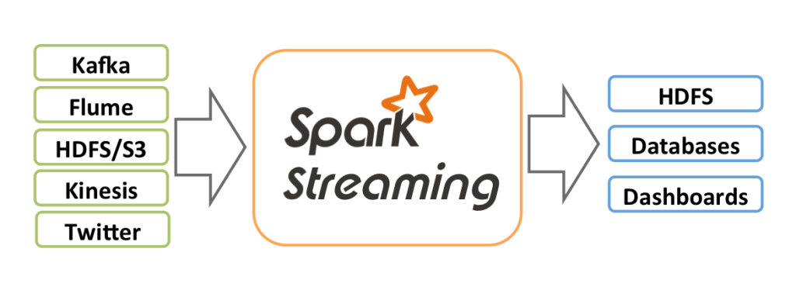

Slide 40
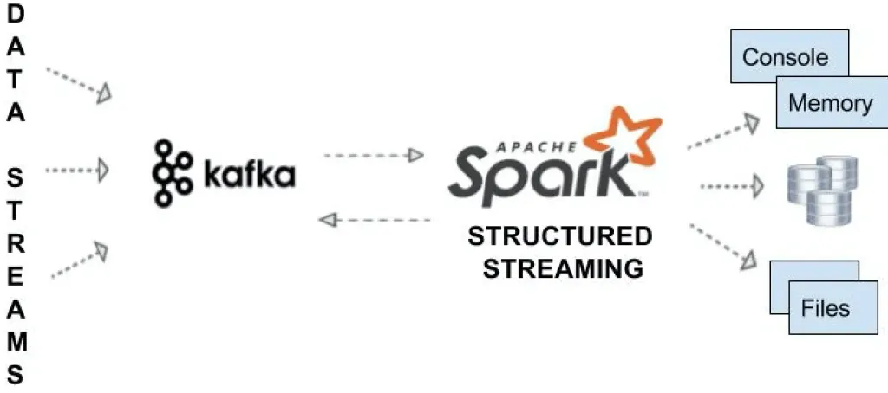
Streaming from Kafka
Using Spark Streaming we can read from Kafka topic and write to Kafka topic in TEXT, CSV, AVRO and JSON formats

Slide 41
# Stream from Kafka
df = spark.readStream
.format("kafka")
.option("kafka.bootstrap.servers", "192.168.1.100:9092")
.option("subscribe", "json_topic")
.option("startingOffsets", "earliest") // From starting
.load()

Slide 42
# Stream write to kafka
df.selectExpr("CAST(id AS STRING) AS key", "to_json(struct(*)) AS value")
.writeStream
.format("kafka")
.outputMode("append")
.option("kafka.bootstrap.servers", "192.168.1.100:9092")
.option("topic", "josn_data_topic")
.start()
.awaitTermination()

Slide 43
PySpark MLlib
PySpark MLlib is Apache Spark’s scalable machine learning library, offering a suite of algorithms and tools for building, training, and deploying machine learning models.
It provides implementations of popular algorithms for classification, regression, clustering, collaborative filtering, and more.

Slide 44
MLlib is designed for distributed computing, allowing it to handle large-scale datasets across clusters efficiently. It offers both high-level APIs for ease of use and low-level APIs for fine-grained control over model training and evaluation.
MLlib seamlessly integrates with Spark’s ecosystem, enabling end-to-end machine learning workflows, including data preprocessing, feature engineering, model training, and deployment in production environments.

Slide 45
PySpark GraphFrames
PySpark GraphFrames were introduced since Spark 3.0 to enable Graphs on Data Frames. Prior to 3.0, Spark had a GraphX library that supported only RDD.
Spark GraphFrames is a graph processing library built on top of Apache Spark that allows developers to work with graph data structures in a distributed and scalable manner.
GraphFrames enables you to analyze and manipulate relationships between entities, represented as vertices (nodes) and edges (connections), using the power of Spark’s distributed computing engine.

